Slide 1
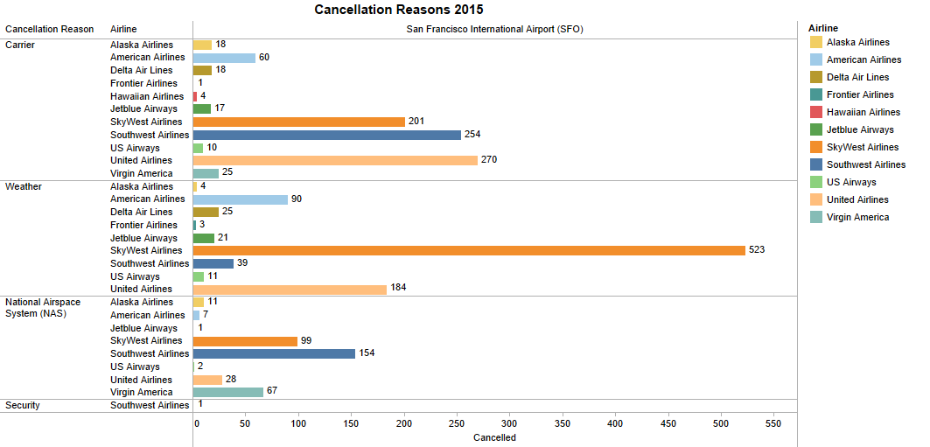
Sum of Cancelled for each Airline broken down by Airport Origin vs. Cancellation Reason.
Colour shows details about the Airline.
This view is filtered on Cancellation Reason.

